Slide 1
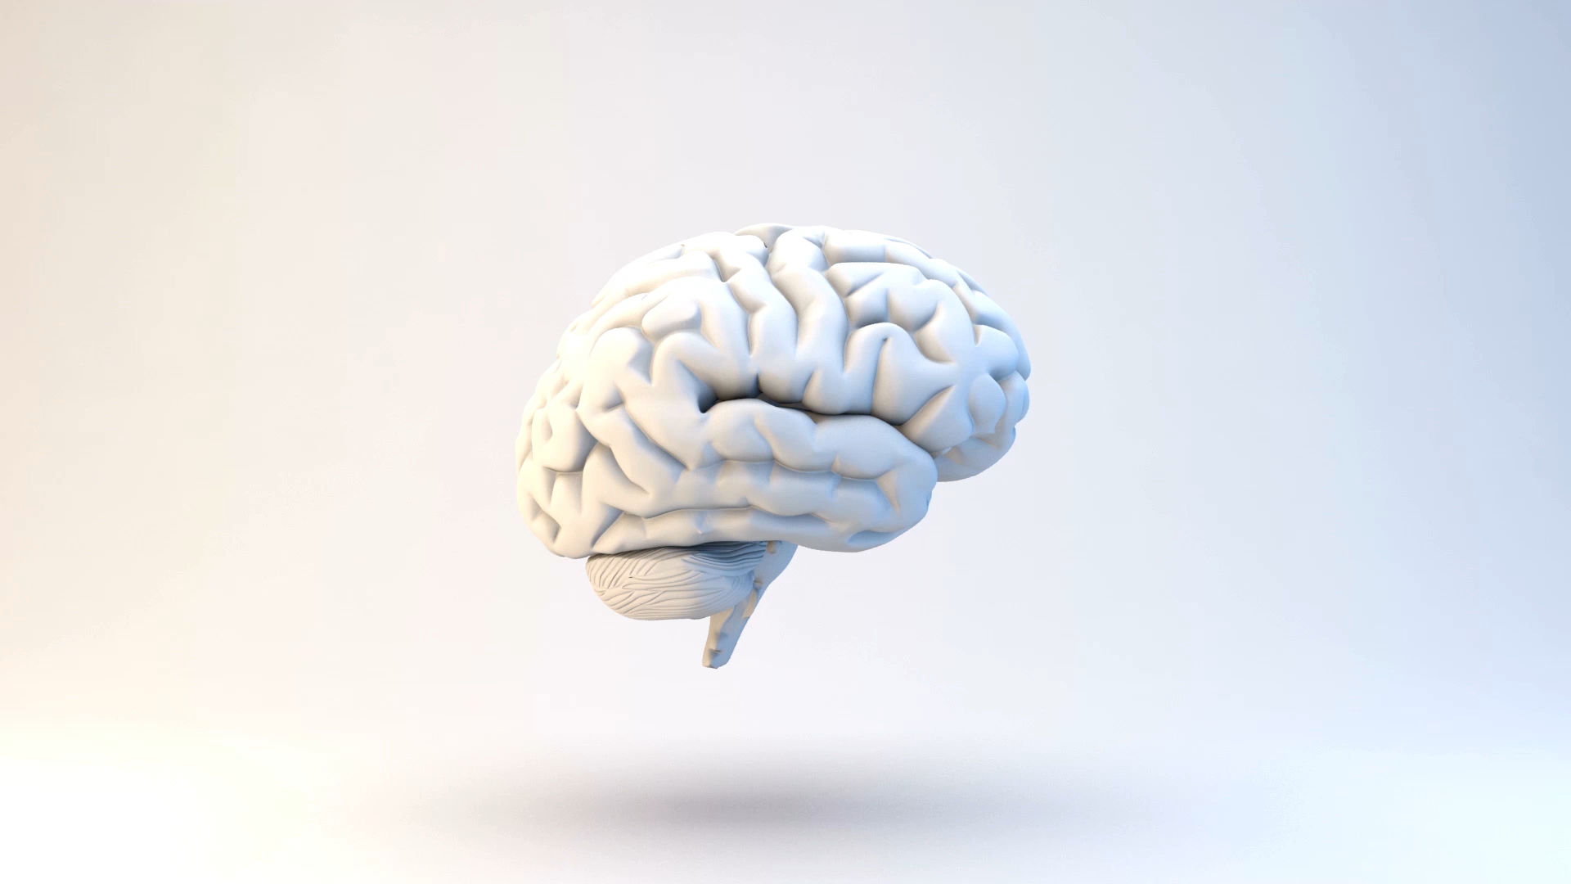

Evaluating the Robustness of Bayesian Neural Networks By Exploiting Uncertainty Estimation
Wasim Essbai – University of Bergamo, Italy
Advisor:
Prof. Angelo Gargantini

Slide 2
Motivations
Machine Learning Models (MLMs) and especially Neural Networks (NNs) are used in data classiﬁcation, also for performing critical tasks
Normally used as black box
Extensive learning can be applied
But what happens when data are altered due to some faults/errors in the image acquisition process?
Not only adversarial examples
Testing NNs
What is their robustness?
See P. Arcaini, A. Bombarda, S. Bonfanti, and A. Gargantini. Dealing with robustness of convolutional neural networks for image classiﬁcation. In 2020 IEEE International Conference On Artiﬁcial Intelligence Testing (AITest)

Slide 3
Outline
Bayesian Neural Networks (BNNs)
Classification using uncertainty
Alterations
Robustness
Lesson learned

Slide 4
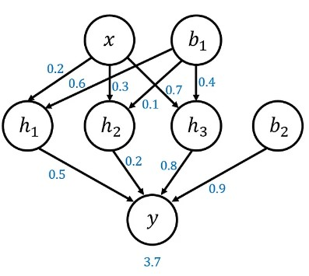
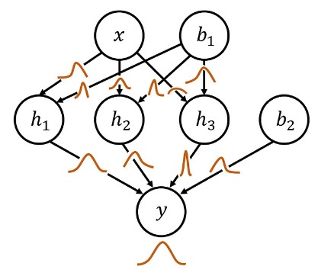
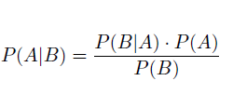
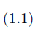
Bayesian Neural Networks
A standard network
Why?
Bayesian network
Uncertainty estimation!
Aleatoric: Related to the inputs
Espistemic: Related to the model
Bayes’ Theorem

Slide 5


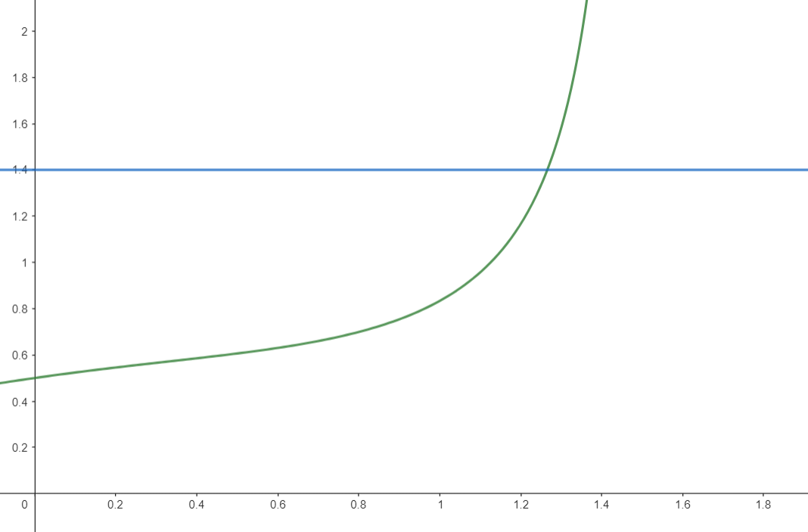
Classification using uncertainty
How to define the threshold?
e.g.
Prediction
A possible choice is a linear approximation
BNN
Input
$$threshold=maxUnc(1−conf_level)$$
I don’t know
??
Idea:
Whenever the uncertainty surpasses a defined threshold the network outputs an unknown statement.

Slide 6
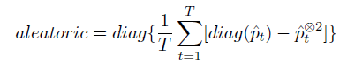
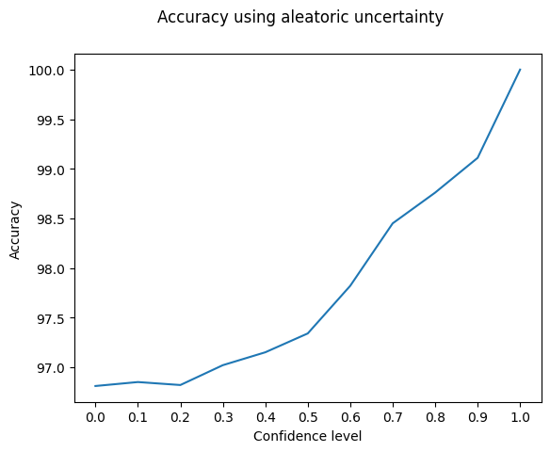
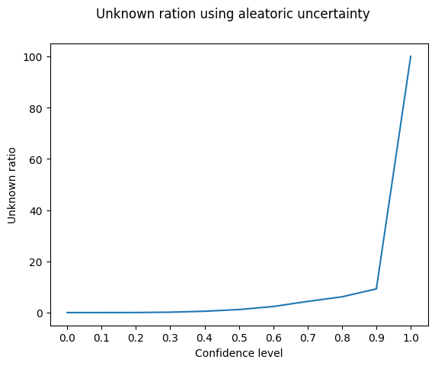
Aleatoric uncertainty
$$threshold=0.9(1−conf_level)$$

Slide 7
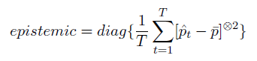
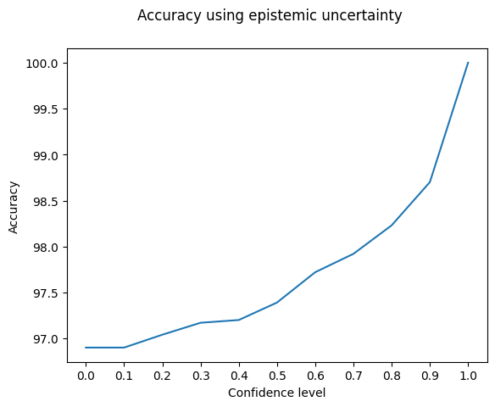
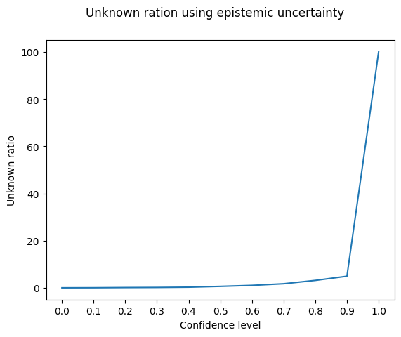
Epistemic uncertainty
$$threshold=0.2(1−conf_level)$$

Slide 8
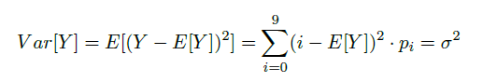
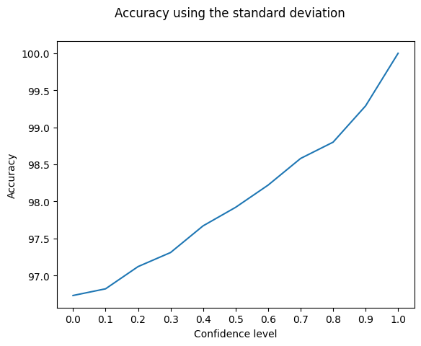
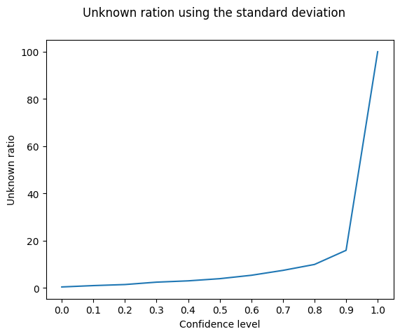
Standard deviation
$$threshold=2.87(1−conf_level)$$

Slide 9
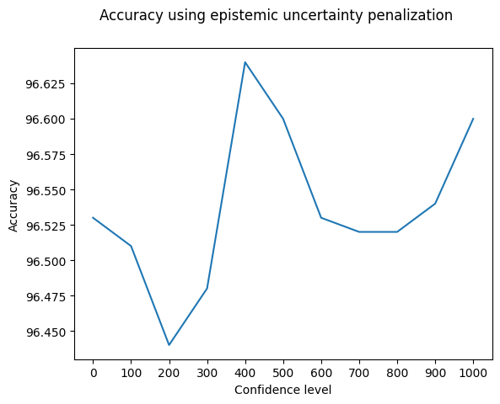
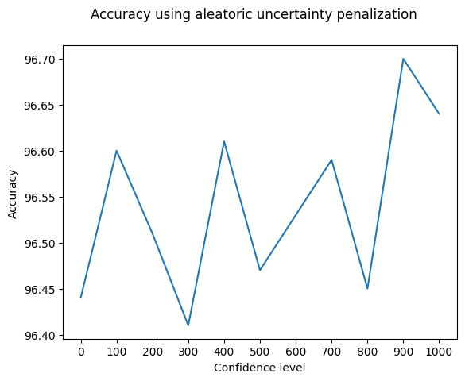
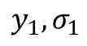
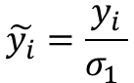
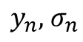
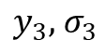
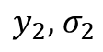
Uncertainty penalization
Output layer
First L-1 layers
$$y_{1}, σ_{1}$$
$$y_{2},{ σ}_{2}$$
$$\tilde{y_{i}}=\frac{y_{i}}{σ_{1} }$$
...
$$y_{3},{ σ}_{3}$$
$$y_{n},{ σ}_{n}$$

Slide 10
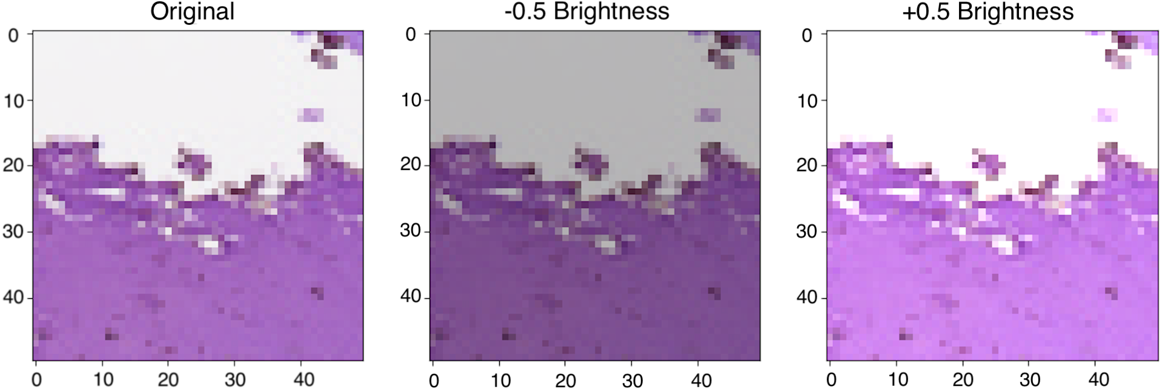
Alterations
An alteration of type A is a transformation of the input that mimics the possible effects over the inputs when a problem occurs
Given an alteration of type A, there is a range of plausible alterations of type A
Example: increase the brightness +- 10%, blur…
Alterations are defined by a domain expert
The same concept applies to other types of data: sounds, ..

Slide 11
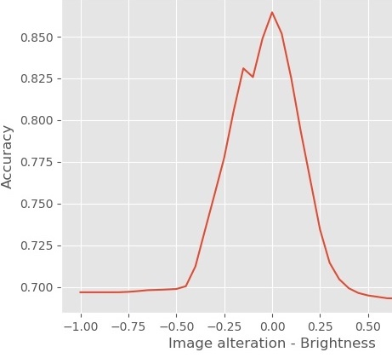
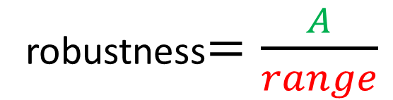
Robustness(1)
By altering the data, the accuracy (% of samples correctly labeled) decreases
The accuracy should not go below a given threshold
accuracy
The accuracy is above the desired threshold
threshold
robustness$=\frac{A}{range}$
A
Robustness = 1 means that the accuracy is always above the threshold
alteration
range

Slide 12
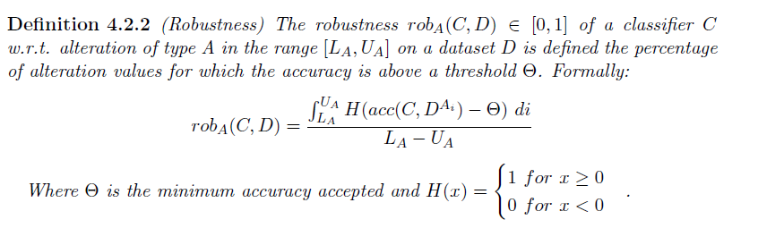
Robustness (2)
Limitations?
It does not measure how much above the threshold
We can use a different function, but which one?

Slide 13
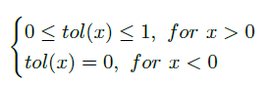
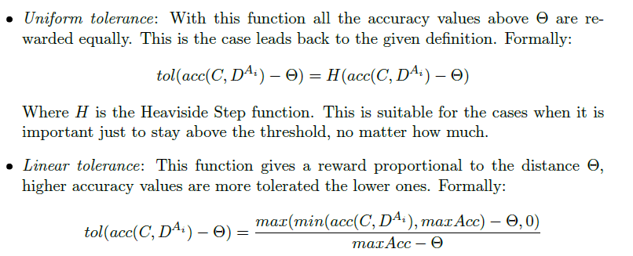
Tolerance
Some examples:

Slide 14
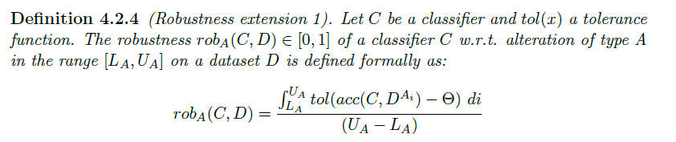
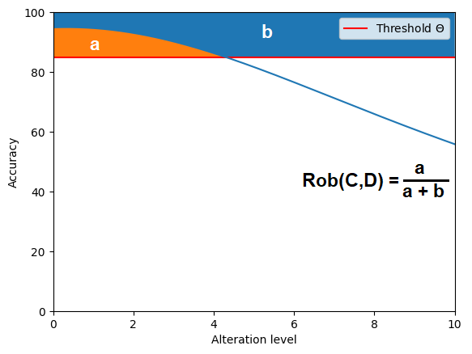
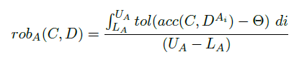
Robustness (3)

Slide 15
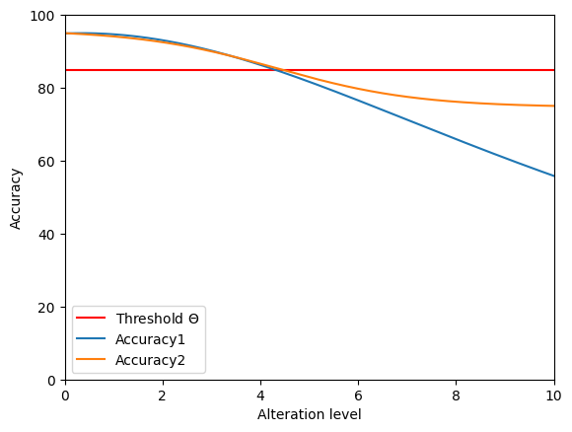
Robustness (4)
What happens after
the threshold?

Slide 16
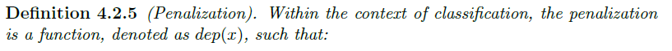
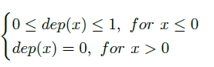
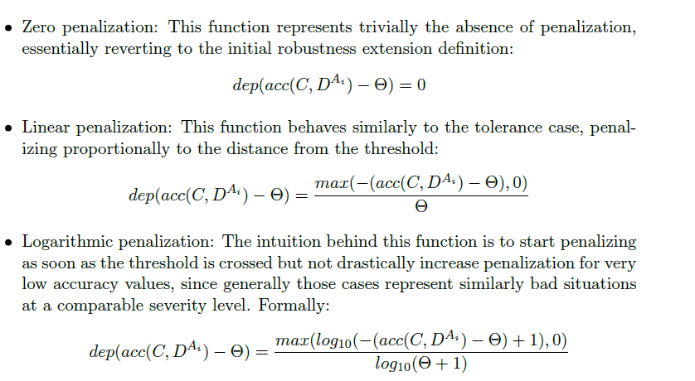
Penalization
Some examples:

Slide 17
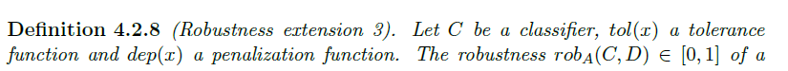
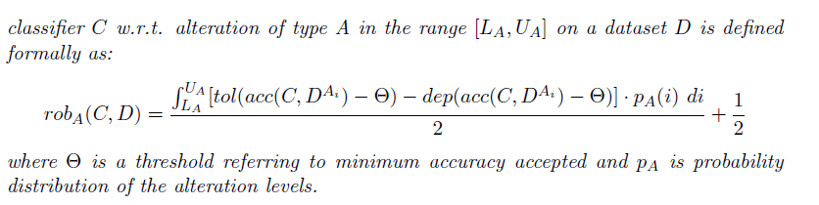
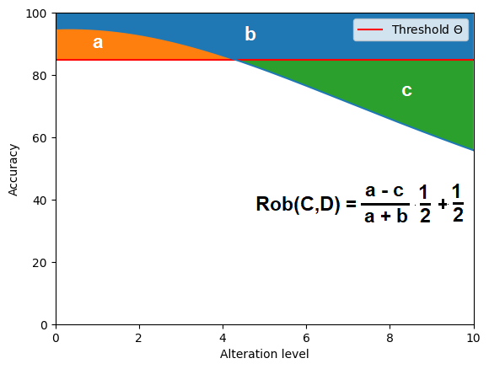
Robustness (5)

Slide 18

But where is the uncertainty?..

Slide 19

Robustness against indecision
So far we dealed with approaches applicable always
In fact, we can directly apply them using the accuracy of the BNN
The uncertainty is considered during the classification
But…
What if we have only unknown outputs?
The uncertainty would 100%
The network is useless!

Slide 20
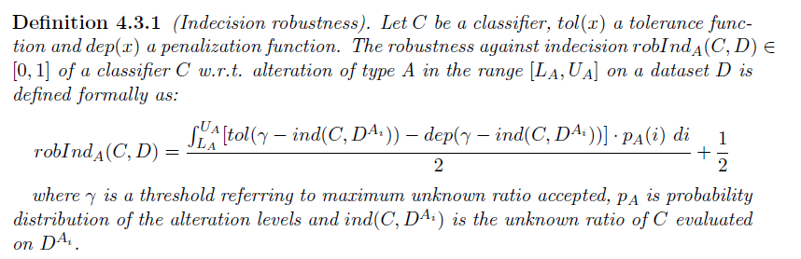
Robustness against indecision

Slide 21
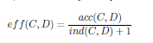
Can we combine the two metrics?
The idea is to combine the unknown ratio with the accuracy in someway to get a global metric
This new metric should reflect the accuracy When the network has an unknown ratio equal to zero;
When there are unknown predictions, it should be lower than the accuracy.
A first idea would be a ratio:
We call it effectiveness

Slide 22
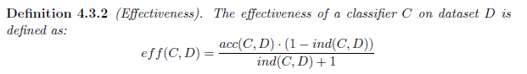
Effectiveness (1)
*The added factor serves to push the score to zero when only unknown are outputted

Slide 23
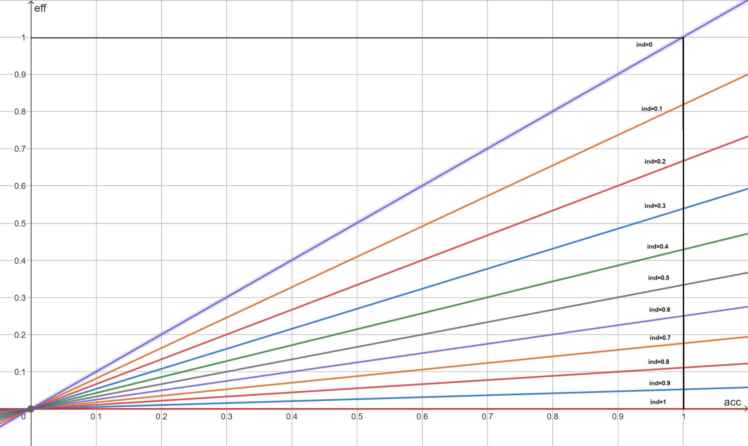
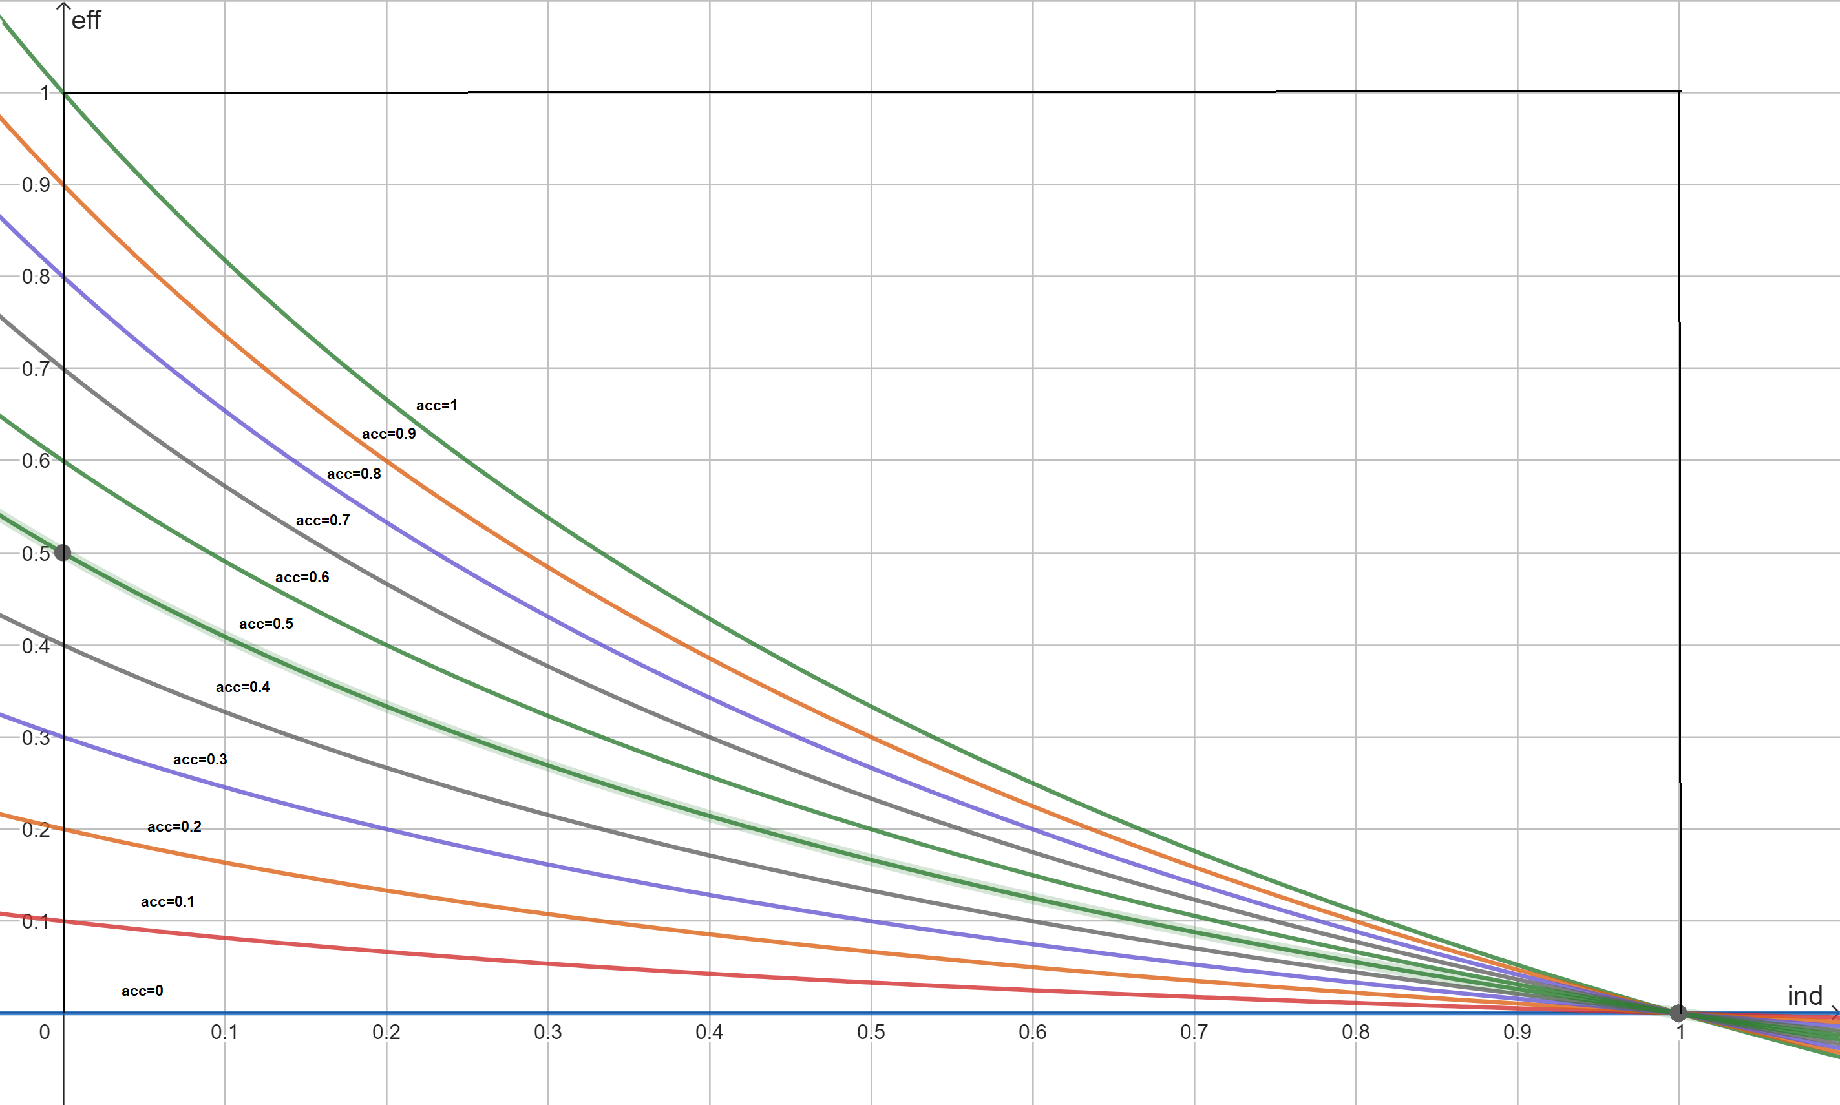
Effectiveness (2)

Slide 24
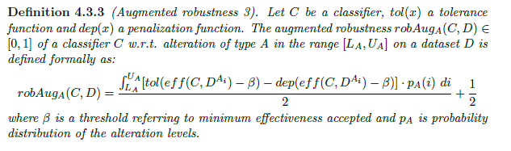
Effectiveness (3)

Slide 25
Some lessons learned
Uncertainty estimation can help in the reduction of wrong predictions and it is an inherent characteristic that improves the robustness;
When dealing with uncertainty, it is not enough to consider the accuracy as metric;
The uncertainty must be included in the evaluation.

Slide 26


Arigato
Gosaimasu

